Slide 1
CIS 112
Generic Programming

Slide 2
Objects
Clone vs Deep Clone
Java Generics
Iterators
List Iterators
Iterable Interface
Enhanced For Loop

Slide 3
An Object data type can be used to write Generic methods
public Integer max(Integer[] data)
public Object max(Object[] data)
Return an Object may require a cast
I = (Integer) max(intArray)
and/or a check for type
if ( I instanceof Integer)
{
// safe to call Integer methods
}

Slide 4
Clone (or copy)
Creating a clone of an Object clones the reference
not the Object.
Adding or Removing a value from a cloned collection is OK,
but changing the value of an Object will change the value in
the Original Collection
May need a Deep Clone to clone the Object instead

Slide 5
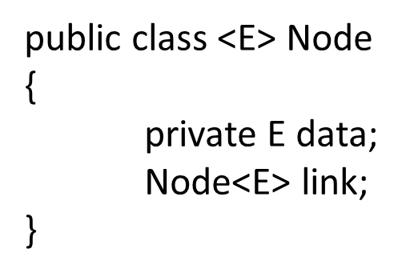
public class IntNode
{
private int data;
intNode link;
}

Slide 6
Iterators provide a generic interface
for parsing a Collection
They promise:
public boolean hasNext()
public E next()
public void remove()
List Iterators add reverse scanning

